Slide 1
Goal:
Build an app that tracks my time 24 / 7.
That helps me see how I’m wasting time, and how I can improve how I use time.

Slide 2

2.0
1.0
0.5
Phone Icons
Phone Icons
Phone Icons
TIMII
TIMII
TIMII
+
+
+
To Do
Checkbox
Name
Name
Name
Name
Name
Name
Name
Name 1
Name 2
Timer List
Timer List
Eating
00 : 13
Week : 6h 01m
Family Time
00 : 13
Week : 1h 01m
Timer 3
00 : 13
Week : 3h 01m
Eating
00 : 13
Week : 6h 01m
Family Time
00 : 13
Week : 1h 01m
Timer 3
00 : 13
Week : 3h 01m
Eating
00 : 13
Week : 6h 01m
Family Time
00 : 13
Week : 1h 01m
Timer 3
00 : 13
Week : 3h 01m
Calendar
Events
and
Tasks
+
Today
Student
English Class Week : 2h 01m 2-3PM
Search
+
Lomas Week Total: 2h 01m
Lomas Week : 2h 01m EST: 30m
Student
Math 1 Week Total: 2h 01m
Lomas Week Total: 2h 01m EST: 30m
Search
Science Week Total: 2h 01m
+
Math 1 Week Total: 2h 01m EST: 30m
Student
House
Lomas Week : 2h 01m EST: 30m
Science Week Total: 2h 01m EST: 2h
Running Week Total: 2h 01m
My Task
List to
Track
Math 1 Week : 2h 01m EST: 30m
House
Sleeping Week Total: 20h 01m
Running Week Total: 2h 01m EST: 1h
Science Week : 2h 01m EST: 2h
Sleeping Week Total: 20h 01m EST: 8h
House
Navigation Footer
Navigation Footer
Navigation Footer
Navigation Footer
Jul 1, 2019
Jan 1, 2019
Aug 31, 2018
May 28, 2018 - 3

Slide 3
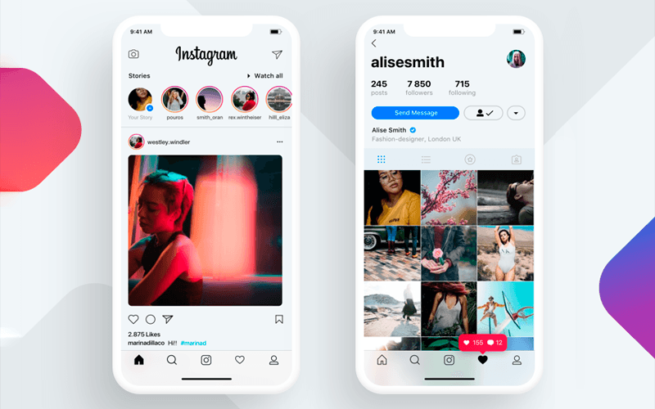

Slide 4
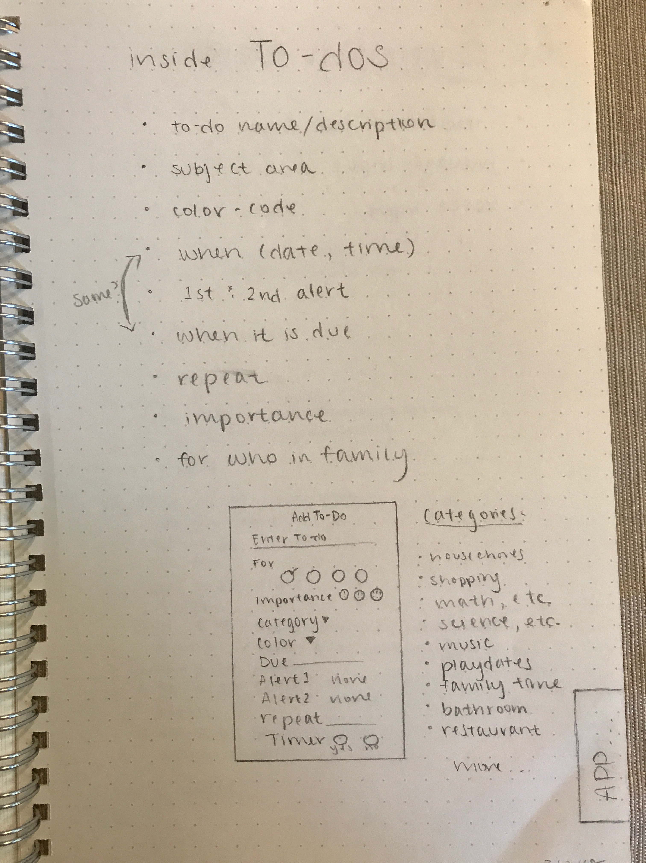
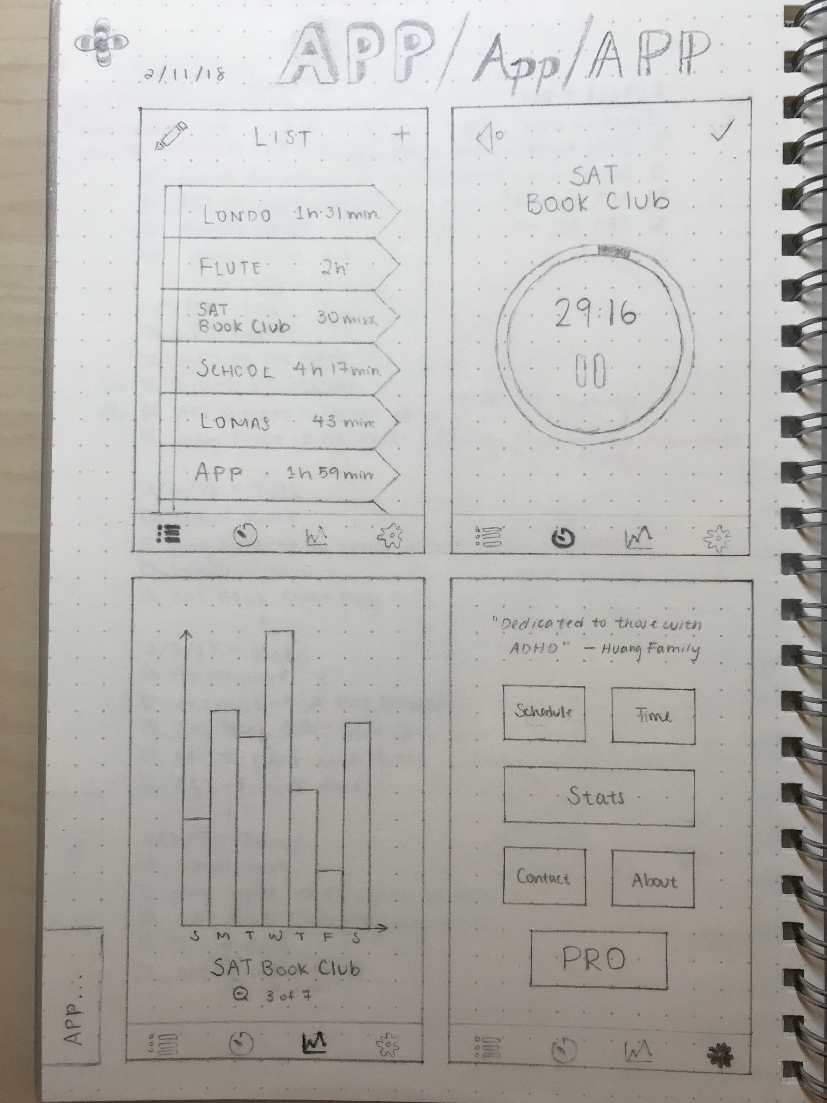
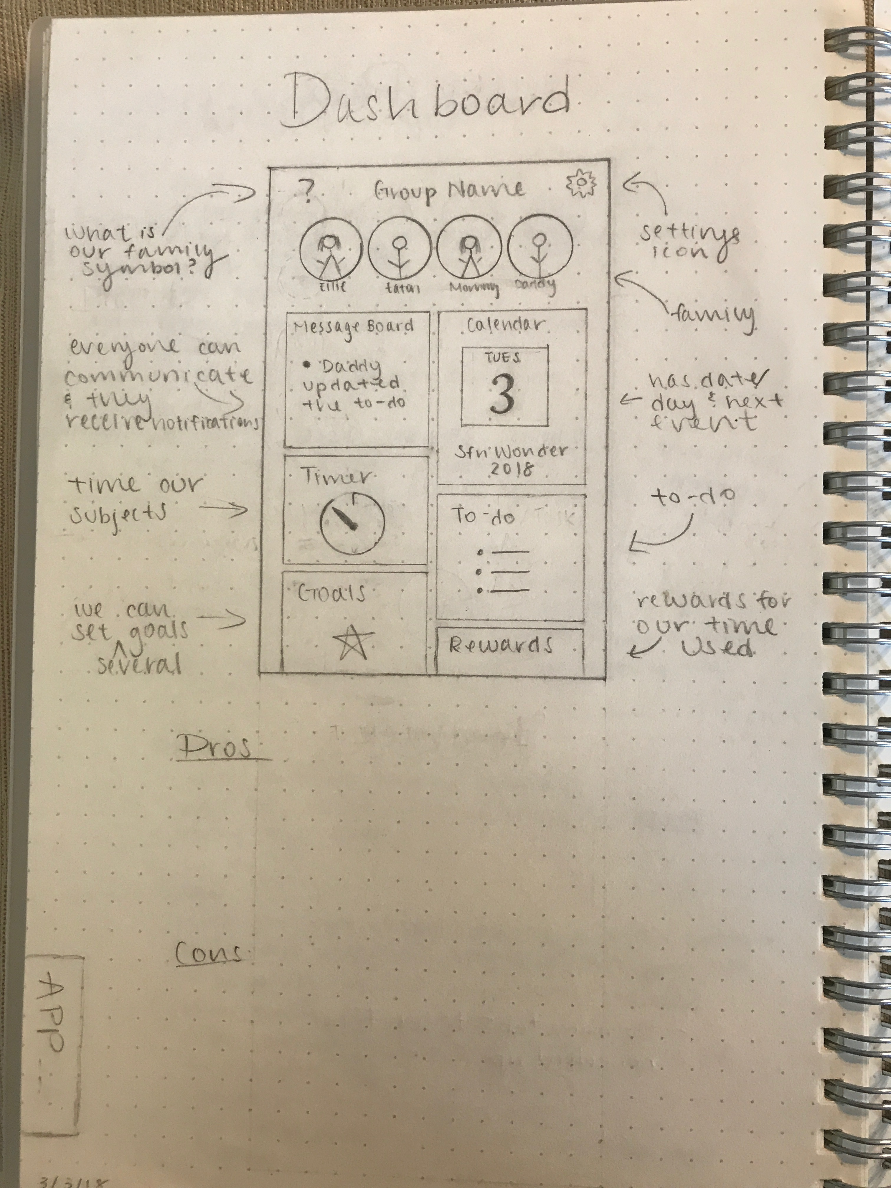
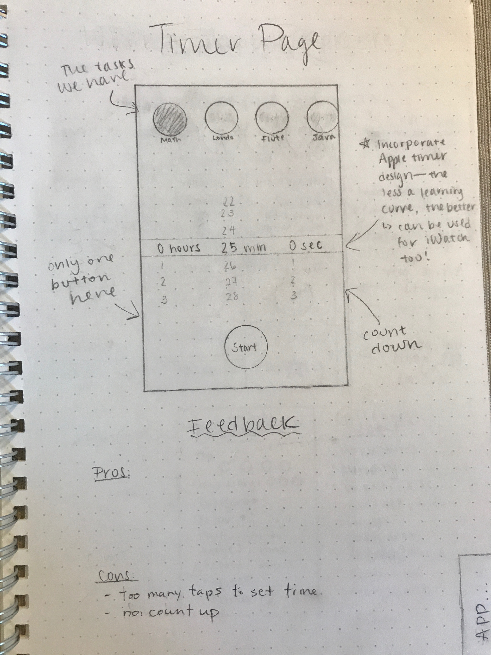

Slide 5
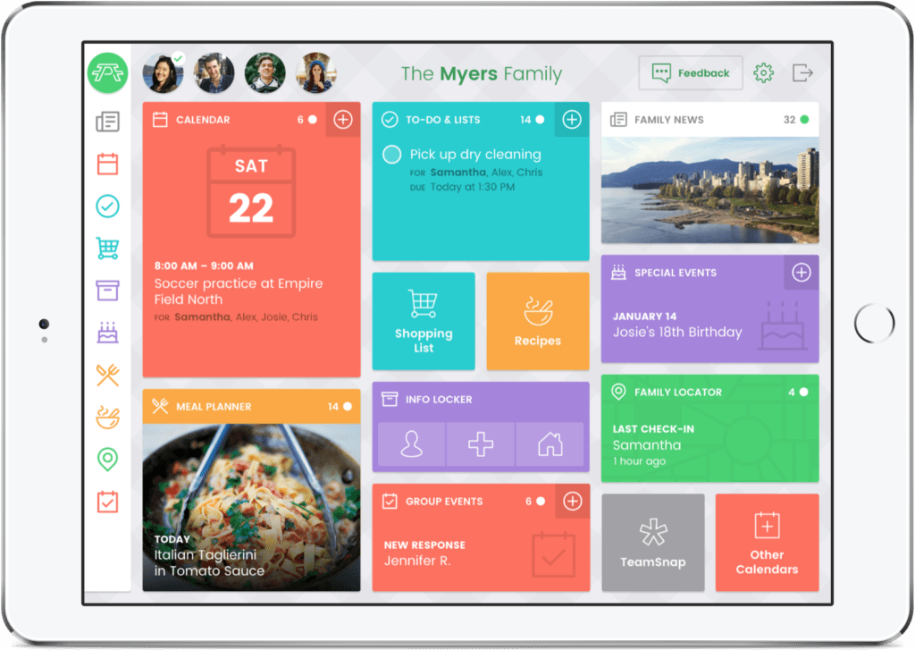
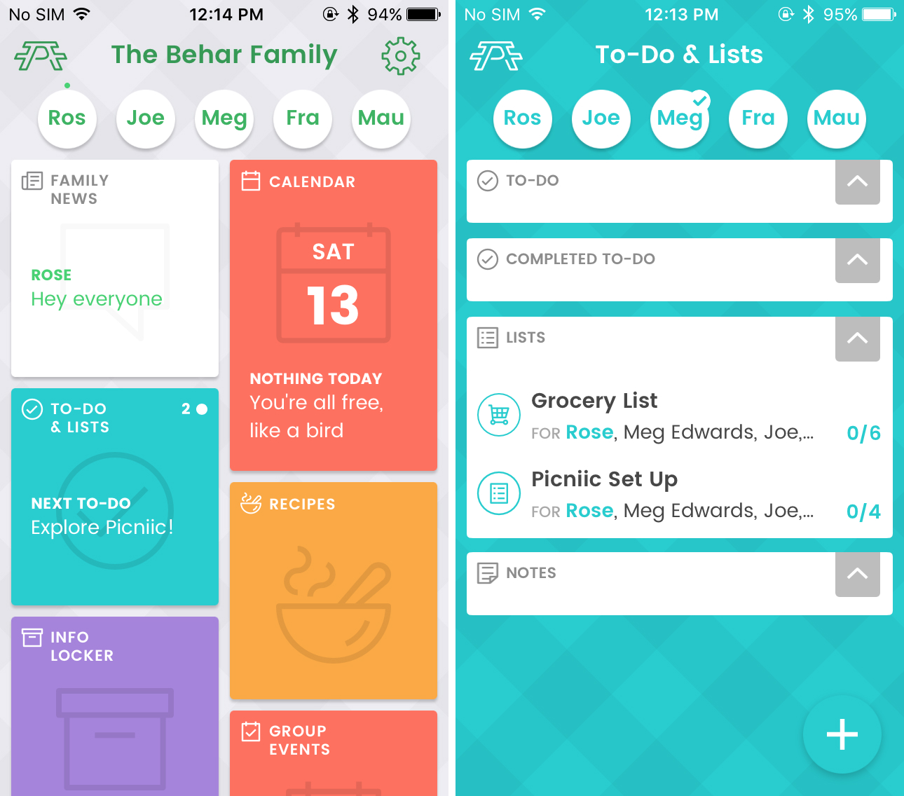
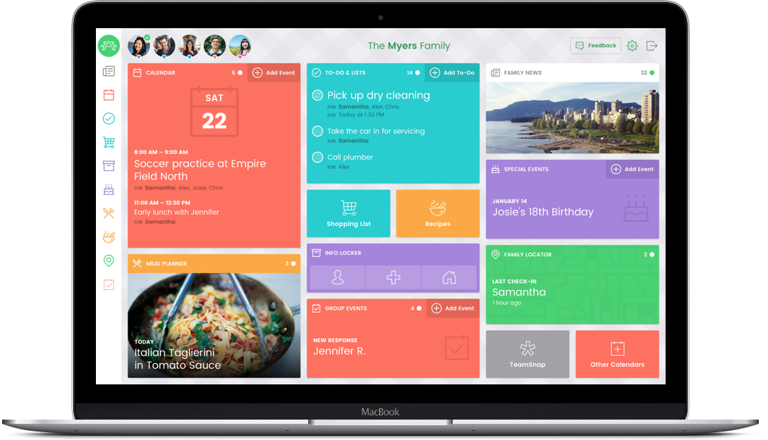

Slide 6
External tools

Slide 7
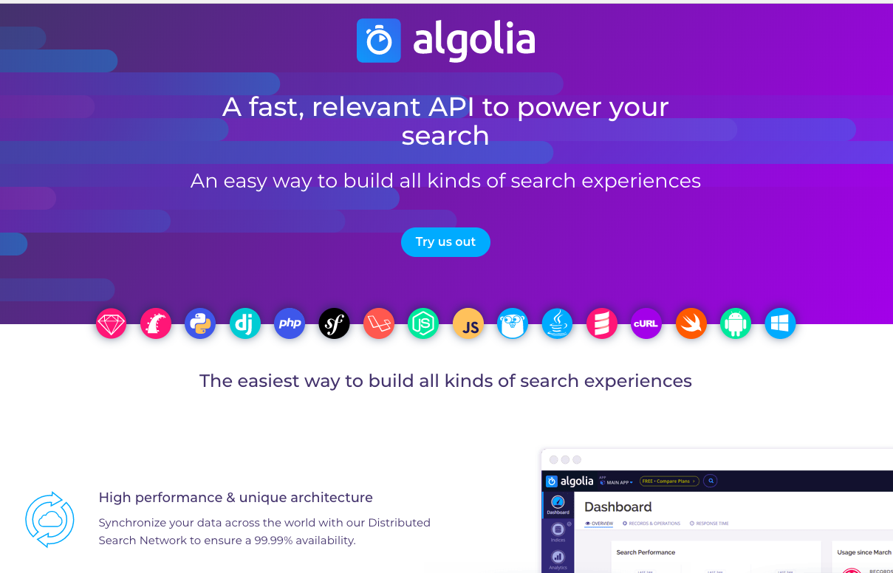
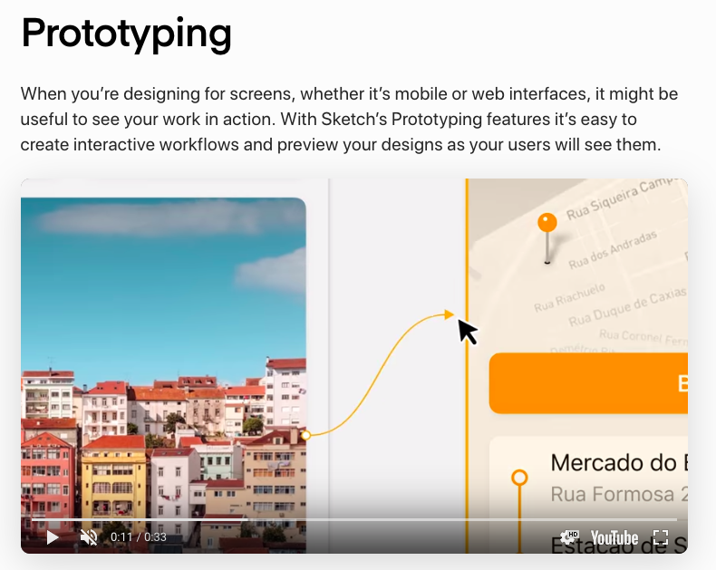
For in APP search
For UI/UX Wireframe and Prototype artwork layout

Slide 8
Archive

Slide 9
2.0
1.0
0.5
Phone Icons
Phone Icons
Phone Icons
TIMII
TIMII
TIMII
+
Name
Name
Name
Name
Name
Name
Name
Name
Name
Calendar Dashboard
Stats / Reporting Dashboard
Timer Dashboard
+
Math 1
Week Total: 5h 31m
Lomas
Week Total: 2h 01m
Eating
00 : 13
Week Total: 6h 01m
Family Time
00 : 13
Week Total: 1h 01m
Navigation Footer
Navigation Footer
Navigation Footer
Jul 1, 2019
Jan 1, 2019
Aug 31, 2018
May 28, 2018 - 1

Slide 10

2.0
1.0
0.5
Phone Icons
Phone Icons
Phone Icons
TIMII
TIMII
TIMII
+
+
+
Name
Name
Name
Name
Name
Name
Name
Name
Name
Name
Name
Name
Dashboard
Dashboard
Dashboard
Message Board
Calendar
To Do Timer
Stats
To Do Timer
To Do Timer
Stats
DB
DB
DB
Jul 1, 2019
Jan 1, 2019
Jul 1, 2018

Slide 11
2.0
1.0
0.5
Phone Icons
Phone Icons
Phone Icons
Logo
Logo
Logo
People
People
People
+
+
+
Message Board
Calendar
To Do Timer
Message Board
To Do Timer
To Do Timer
Stats
Navigation Footer
Navigation Footer
Navigation Footer
Jul 1, 2019
Jan 1, 2019
Jul 1, 2018

